Slide 1
Business Model
By Blake Opial, Evan Kiser, John Hudnall, Devin Pardo

Slide 2
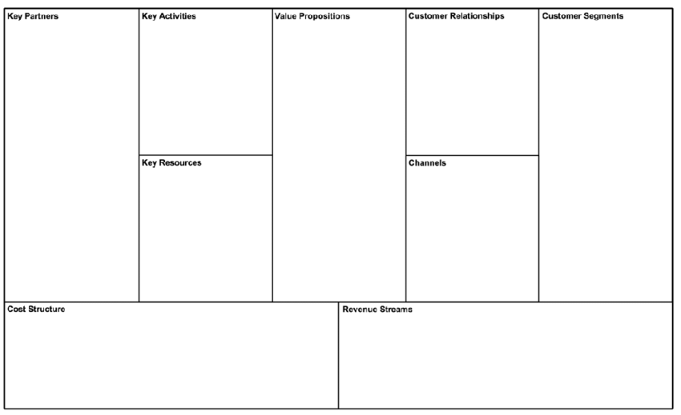
LSU Administration
LSU Registration Services
Designing a user-friendly scheduling tool
An active customer support to fix errors and take suggestions
E-mails
Phone Calls
Discord
All current and incoming LSU students
LSU administration
Better UI
New visuals for day by day scheduling
Easier searching for classes
Back-End/Front-End developers
Marketing Team
Dedicated Server
Email marketing
Networking
Business Proposal
Development Costs
Marketing Expenses
Continued upkeep of the platform
Implementing New Features
One Time Payment from the client to obtain the product
Additional features can be purchased separately as the client sees need for them.

